Slide 1
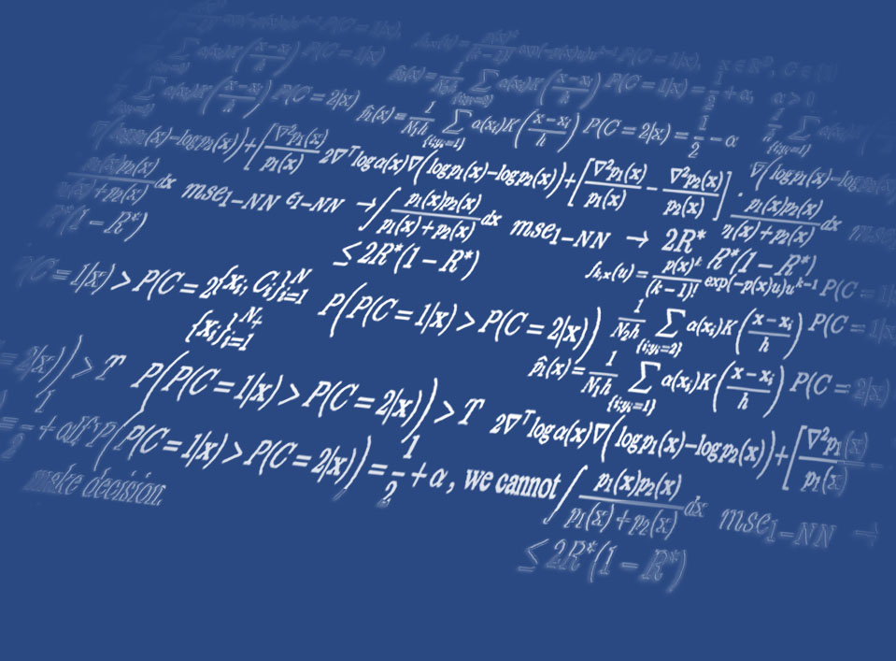


Diffusion Models
2024 Machine Learning Algorithms class
Yung-Kyun Noh (노영균)
Hanyang University &
Korea Institute for Advanced Study
Hanyang University

Slide 2
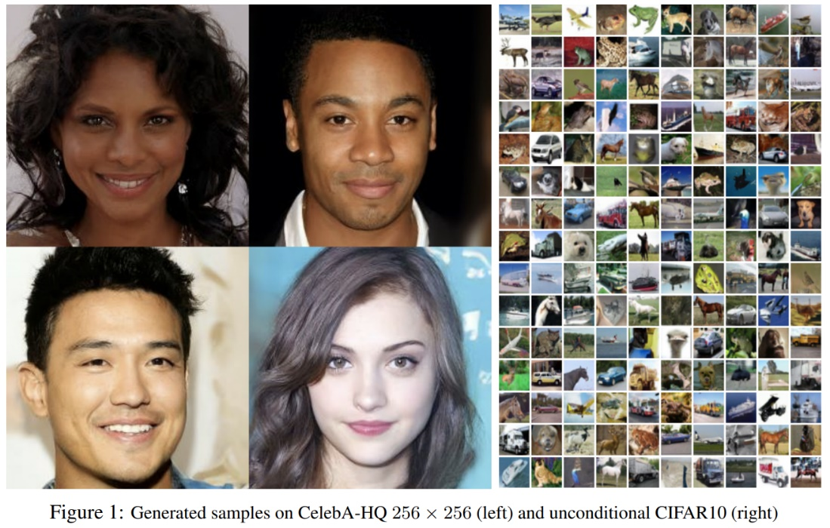
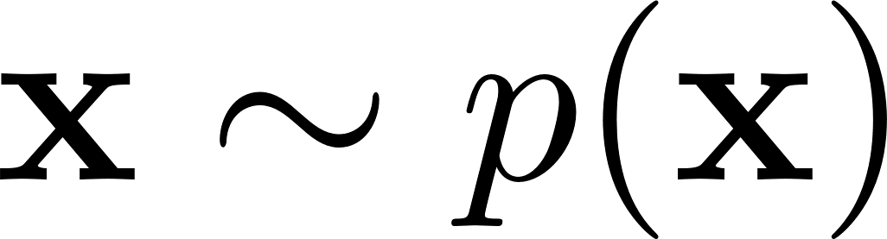
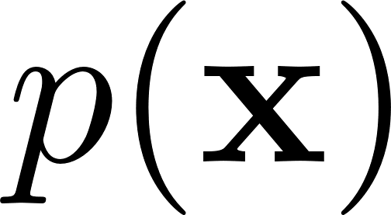


Data Generation

Slide 3
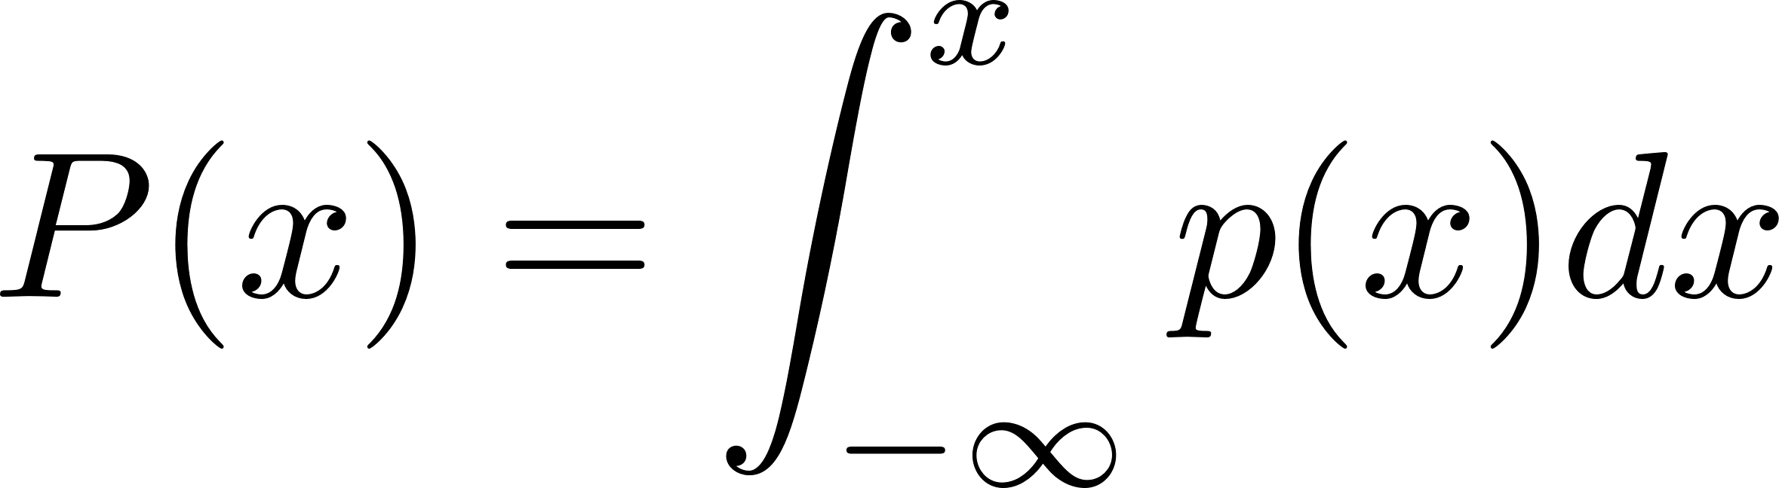

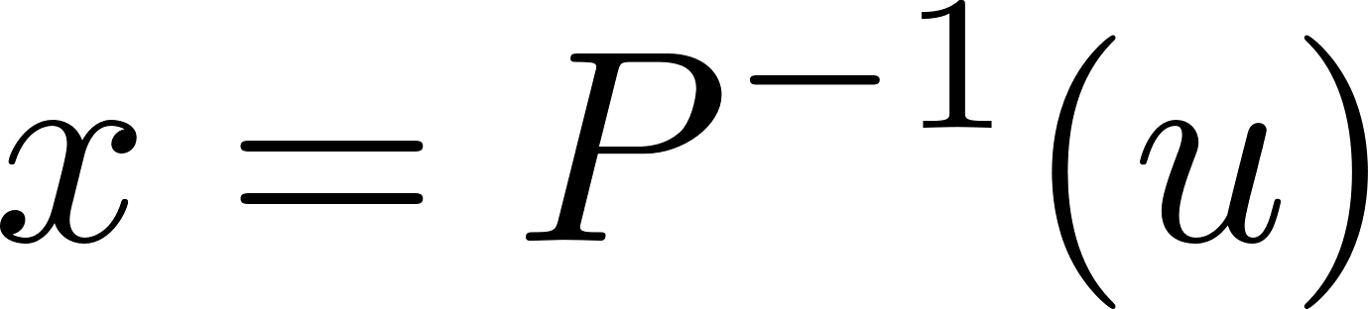
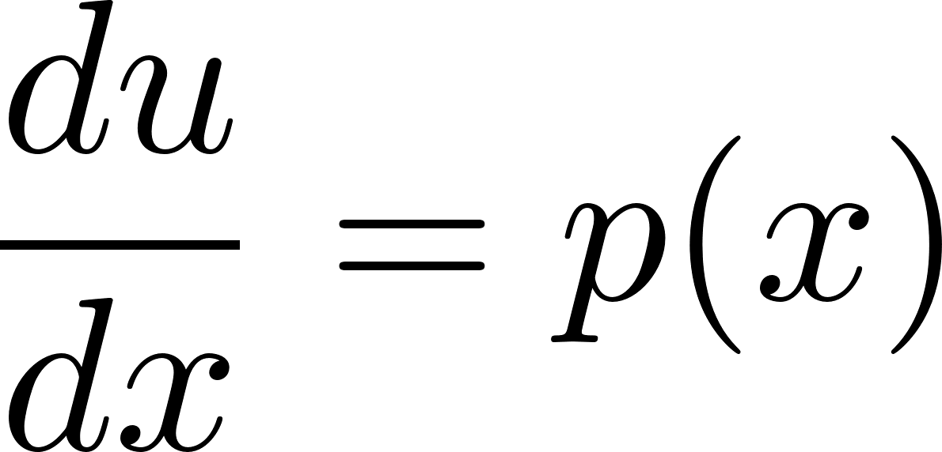
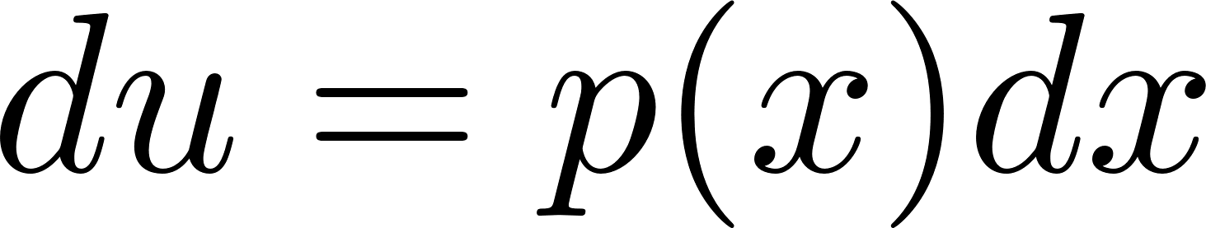
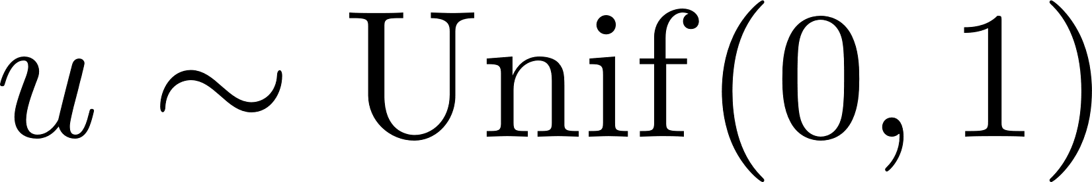
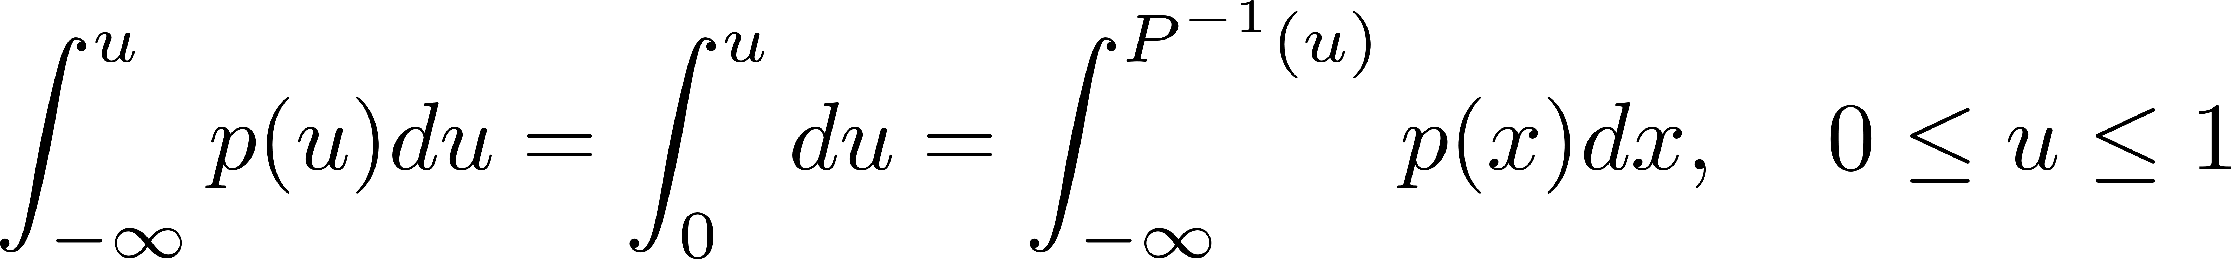
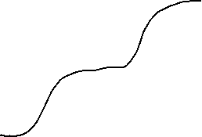

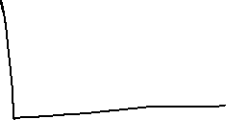
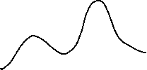
Data Generation 101
Cumulative distribution

Slide 4
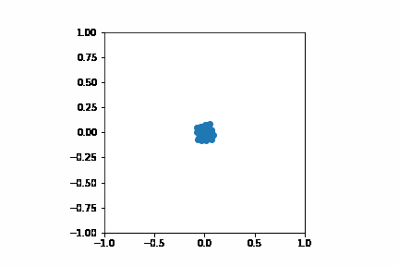
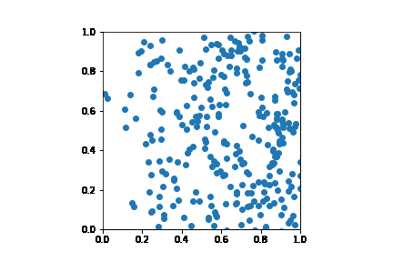
Diffusion

Slide 5
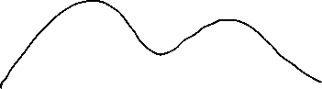
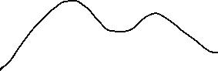
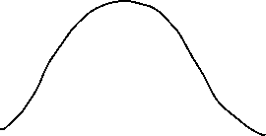
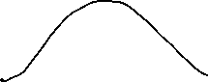
Diffusion of Non-Uniform Density
Diffusion of Non-uniform density makes a global flow
Reverse process in diffusion model reconstructs the backward global flow.
Noise
Noise

Slide 6
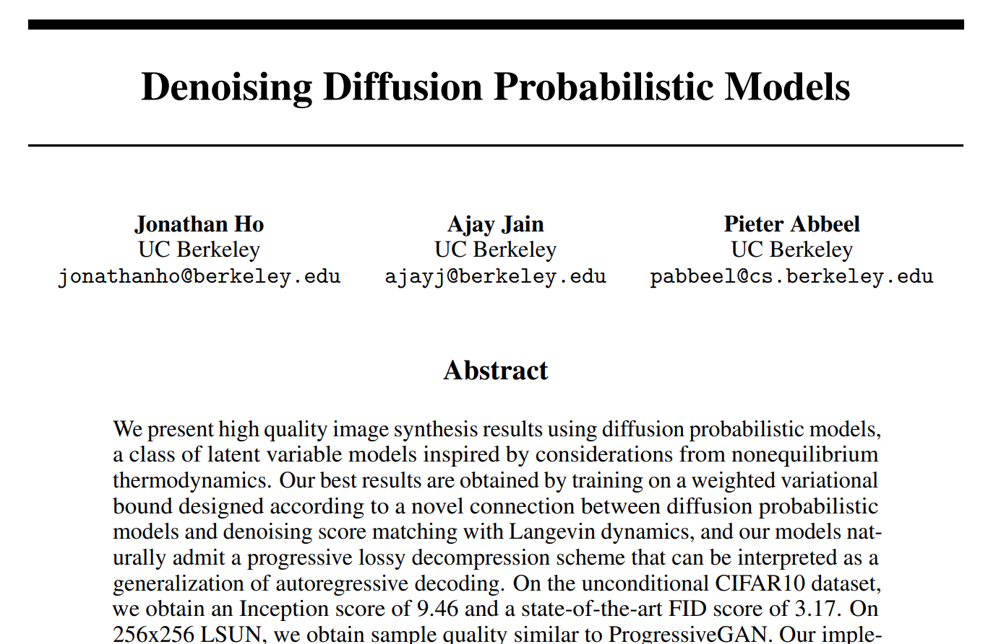
NeurIPS 2020

Slide 7

i
s
s
d
D
f
i
n
M
o
o
l
f
u
e
s

Slide 8


Slide 9
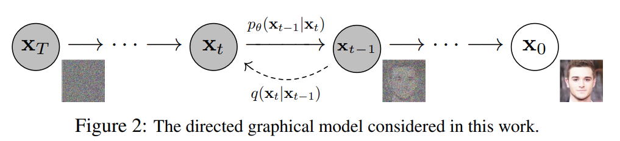
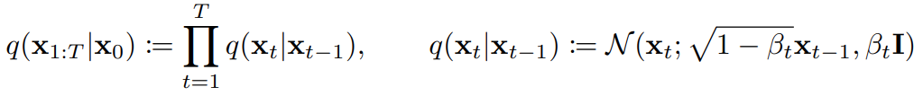
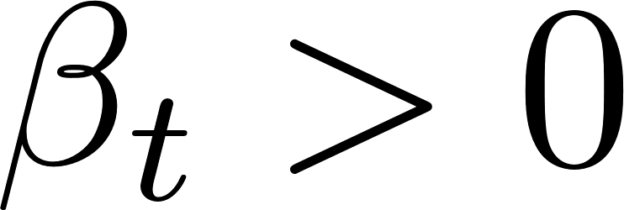
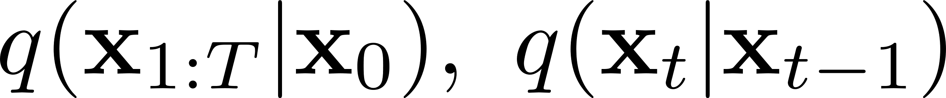
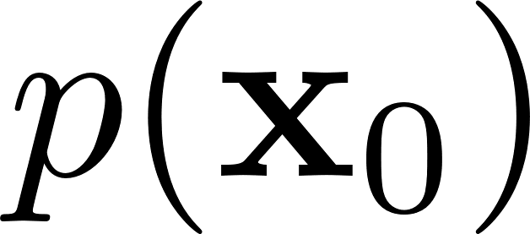
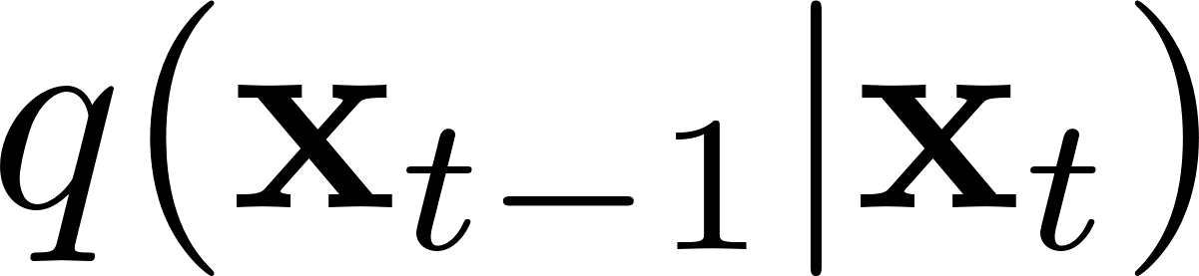
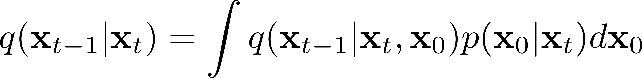
Underlying Dffusion Procedure
Data
: Gaussians
Caution)
If is Gaussian,
: Not Gaussian
is Gaussian.
: Gaussian mixture

Slide 10
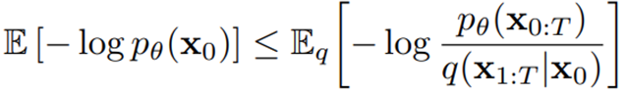
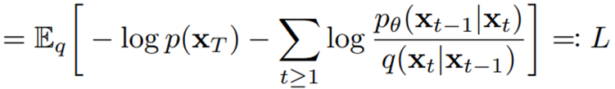
Model for Reverse Process
Objective function:
Look at the derivations in the next two pages…

Slide 11
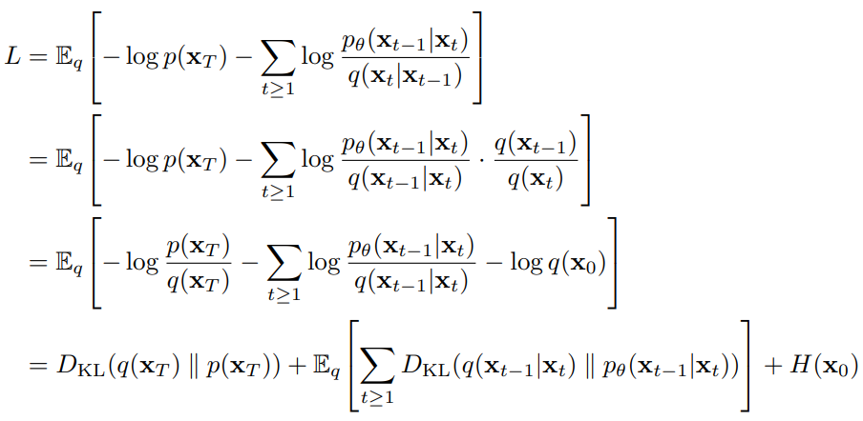
Constructing Objective Functions - 1
Can we have this density function?

Slide 12
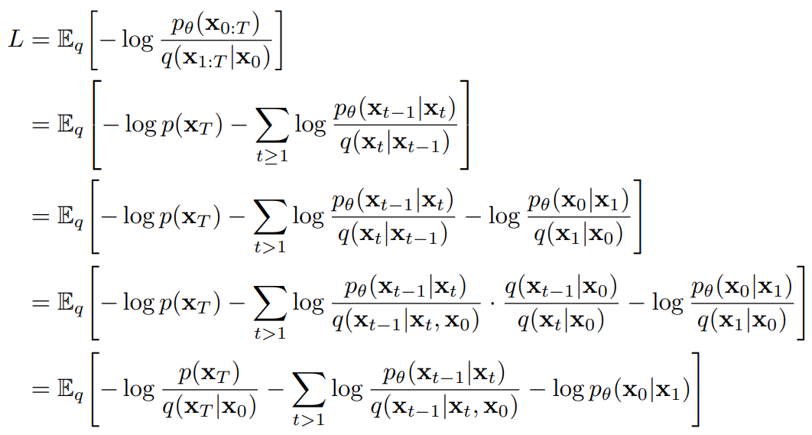
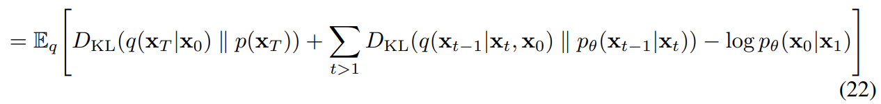

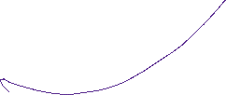
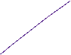
Constructing Objective Functions - 2

Slide 13
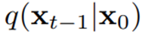
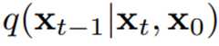
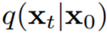
Tractable Functions
Gaussians

Slide 14
Decomposition for Gaussian Inference

Slide 15
Decomposition for Gaussian Inference

Slide 16
Decomposition for Inference

Slide 17
Gaussian Random Variable – Marginalization
Notes:
w: Sigma의 특성을 뽑아내는 마법

Slide 18

Gaussian Random Variable – Marginal

Slide 19
Gaussian Random Variable – Conditioning
Notes:
w: Sigma의 특성을 뽑아내는 마법

Slide 20








Diffusion and Reverse Process

Slide 21
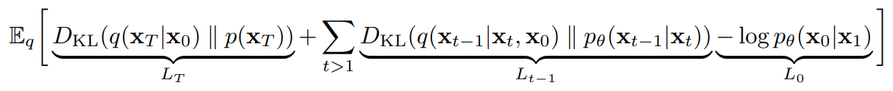
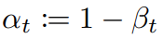
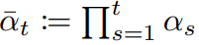
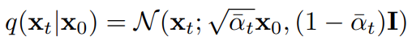
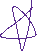
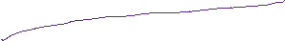
Given , everything is Gaussian. (Joint is not.)

Slide 22
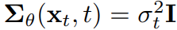
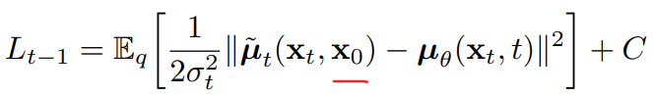




- Model
- K-L divergence:

Slide 23
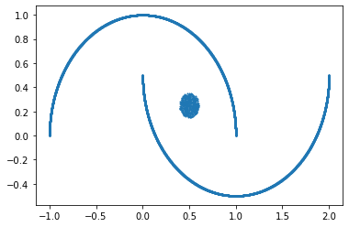
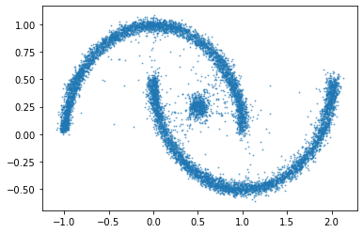
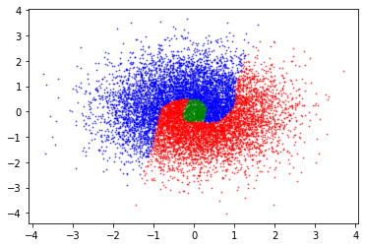

Slide 24
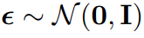
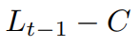

Conditional Mean
=
Recall

Slide 25




- New parameterization
Notes:
x_t가 나왔으면 \epsilon이 무엇이었을가?

Slide 26


Learning without Generating x_{1,} x_{2, …,} x_{t-1}
From , generate , then predict $ε$.
The distribution of is determined by the distribution of . “Distribution of $ε$ is isotropic Gaussian (non-informative) for a given .”
After marginalization, the expectation becomes the global flow of data due to diffusion.

Slide 27

=
Notes:
x_t is the input of \epsilon_\theta

Slide 28


Slide 29

Adding Noise

Slide 30

Results

Slide 31


Interpolation

Slide 32

Classifier-free Guidance

Slide 33





w=-1
w=-0.2
w=0
w=1
w=2
https://github.com/nohyung/2024_Diffusion_models/blob/main/Diffusion_MNIST_Noh_example.ipynb

Slide 34
Summary
Diffusion and Construction of Global Flow
Inference with Gaussians
Learning in DDPM and classifier-free guidance

Slide 35



Thank you
Yung-Kyun Noh
nohyung@hanyang.ac.kr
Notes:
이상입니다. 경청해 주셔서 감사 드립니다.

